Slide 1

Fashion Store Managment
SRM INSTITUTE OF SCIENCE AND TECHNOLOGY
SCHOOL OF COMPUTING
DEPARTMENT OF COMPUTING TECHNOLOGIES
18CSE357T - BIOMETRICS- MINI PROJECT
Batch ID:2
Student 1 Reg. No:RA2311003011185
Student 1 Name:Shreyas Manchanda
Student 2 Reg. No:RA2311003011206
Student 2 Name:Jayant Munde

Slide 2
Objectives
The "Fashion Store Management Program" is a Python and MySQL-based project.
It includes four interconnected database tables: Stock, Sale, Purchase, and Products.
Stock table manages inventory details, Sale table tracks sales, Purchase table logs procurement, and Products table stores product information.
It simplifies daily operations and reduces errors in fashion store management.
This program provides data-driven insights for informed decision-making, aiding stock management, sales trend analysis, and purchase decisions.

Slide 3
Introduction
The "Fashion Store Management Program" is a project developed using Python and MySQL. This project serves as a practical application of programming and database management skills within the context of a fashion retail store. It includes four interconnected database tables: Stock, Sale, Purchase, and Products, allowing us to demonstrate their understanding of inventory management, sales tracking, purchase handling, and product information storage.

Slide 4
System Flow Chart
Establish Database Connection:
Define Functions
Menu Display
User Input
Task Execution

Slide 5
Coding
import os
import platform
import mysql.connector
import pandas as pd
import datetime
mydb=mysql.connector.connect(host="localhost",\ user="root",\ passwd="root",\ database="fashion")
mycursor=mydb.cursor()
def AddProduct():
L=[] stk=[] pid=input("Enter the Product ID : ")
L.append(pid) IName=input("Enter the Product Name : ")
L.append(IName)
brnd=input("Enter the Product Brand Name : ")
L.append(brnd)
fr=input("Enter Male/Female/Kids : ")
L.append(fr) sn=input("Enter Winter/Summer : ")
L.append(sn)
rate=int(input("Enter the Rates for Product :"))
L.append(rate)
product=(L)
sql="Insert into product (product_id,PName,brand,Product_for,Season,rate)values(%s,%s,%s,%s,%s,%s)" mycursor.execute(sql,product)
mydb.commit()
print("One Product inserted ")

Slide 6
Coding
def EditProduct():
pid=input("Enter product ID to be edited : ")
sql="select * from product where product_id=%s"
ed=(pid,)
mycursor.execute(sql,ed)
res=mycursor.fetchall()
for x in res:
print(x)
print("")
fld=input("Enter the field which you want to edit : ")
val=input("Enter the value you want to set : ")
sql="Update product set " + fld +"='" + val + "' where product_id='" + pid + "'"
sq=sql
mycursor.execute(sql)
print("Editing Don : ")
print("After correction the record is : ")
sql="select * from product where product_id=%s"
ed=(pid,)
mycursor.execute(sql,ed)
res=mycursor.fetchall()
for x in res:
print(x)
mydb.commit()

Slide 7
Coding
def ViewProduct():
print("Display Menu: Select the category to display the data")
print("1. All Details")
print("2. Product Name:")
print("3. Product Brand:")
print("4. Product For:")
print("5. Product Season:")
print("6. Product ID:")
x=0
ch=int(input("Enter your choice to display : "))
if ch==1:
sql="select * from product"
mycursor.execute(sql)
res=mycursor.fetchall()
for x in res:
print(x)
x=1
elif ch==2:
var='PName'
val=input("Enter the name of Product : ")
elif ch==3:
var='brand'
val=input("Enter the name of Brand : ")
elif ch==4:
var='Product_for'
val=input("Enter Male/Femal/Kids : ")
elif ch==5:
var='season'
val=input("Enter the Season : ")
elif ch==6:
var='product_id'
val=input("Enter the Product_id : ")
if x==0:
sql="select * from product where " + var + " = %s"
sq=sql
tp=(val,)
mycursor.execute(sq,tp)
res=mycursor.fetchall()
for x in res:
print(x)

Slide 8
Modules
AddProduct()
EditProduct()
DelProduct()
ViewProduct()
PurchaseProduct()
ViewPurchase()
SaleProduct()
ViewSales()
MenuSet() and runAgain()

Slide 9
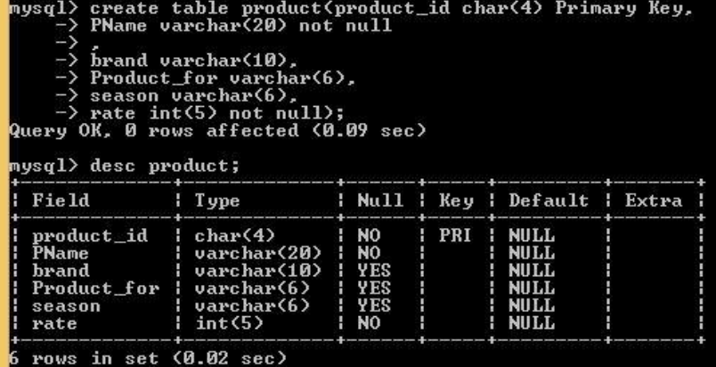
Sample Snapshot
Product Table:

Slide 10
Conclusion
In conclusion, the "Fashion Store Management Program" offers a versatile and efficient solution for managing various aspects of a fashion retail store. With the ability to add, edit, delete, and view product details, as well as facilitate purchase and sales operations, this program provides a comprehensive framework for fashion store management. The user-friendly menu system ensures easy navigation and execution of tasks, while the continuous operation option allows for seamless task repetition. By establishing a connection to a MySQL database, the program enables real-time data management and reporting. To enhance this system, it's important to address indentation issues and implement robust error handling. Overall, this program demonstrates the potential for technology to optimize fashion store operations and serve as a valuable tool for business management.

Slide 11
References
https://www.w3schools.com/python/python_mysql_getstarted.asp

